Slide 1
A Critical Introduction to Economics Slides based on the book by Jäger/Springler: Ökonomie der Internationalen Entwicklung. Eine kritische Einführung in die Volkswirtschaftslehre Chapter 1: A critical introduction

Slide 2
A Critical Introduction to Economics
A book that introduces to economics for beginners
A multi-paradigmatic book which treats different paradigms (neoclassical economics, Keynesianism, political economy) equally
A book which focusses on economic key questions and shows how different paradigms respond to important economic questions
A book which provides deeper insights into selected topics

Slide 3
The structure of the book: Part I: Introduction
Chapter 1: Introduction and Paradigms in economics
a) Historical overview b) Philosophy of science and different paradigms
Chapter 2: Overview of key-paradigms
Neoclassical economics
Post-Keynesian economics
Critical Political Economy

Slide 4
The structure of the book: Part II: Key-issues in economics
Chapter 3: The state, the society and the economy
Chapter 4: Measuring the economy, growth and crisis
Chapter 5: Inequality and distribution of income and wealth
Chapter 6: Money and the financial system
Chapter 7: The geography of the global economy

Slide 5
The chapters have the following structure
1. Neoclassical economics | 2. Post-Keynesian economics | 3. Critical Political Economy
General approach | General approach | General approach
Key-concepts | Key-concepts | Key-concepts
Economic policy implications | Economic policy implications | Economic policy implications
Conclusions, questions for reflection | Conclusions, questions for reflection | Conclusions, questions for reflection

Slide 6
Each chapter comes with boxes written by selected experts in the field
The boxes illustrate the implications of the different paradigms in economics on selected issues:
Gender and feminist economics
Organization of the labour process
European Integration and statehood
Measuring economic wealth
Resource policy
Climate change
Development of distribution policies
The financial crisis
Labour rights, trade and development
The rise of the BRICS countries

Slide 7
Chapter 1: Introduction to economics
What is economics about?
How to understand the economy?
Why are there different perspectives / paradigms in economics?
Different backgrounds in the philosophy of science
What are important questions in economics?
Outline of the lecture / book

Slide 8
1. What is economics about?
Study of the production of material an immaterial goods and services (= economy)
We cannot understand the economy as such but we have to use “theoretical glasses” or perspectives to understand the complex economic phenomena
Use abstract models and concepts to help explain how a complex, real world operates
Develop theoretical perspectives, collect, and analyse data to evaluate the theories

Slide 9
2. How to understand the economy?
The ideas of economists and political philosophers, both when they are right and when they are wrong, are more powerful than is commonly understood. Indeed the world is ruled by little else. Practical men, who believe themselves to be quite exempt from any intellectual influence, are usually the slaves of some defunct economist. (J.M. Keynes)
We should be aware of our implicit understanding of the economy!
We should be able to deal with different approaches in economics and be aware of their implications!

Slide 10
3. Why are there different paradigms in economics?
Historical / societal / economic reasons
Different research interests
Which questions / problems are important?
From the perspective of which interest group should I approach the questions / problems?
Different background in philosophy of science and methodology

Slide 11
Different paradigms to understand the economy
Large /general sets of theoretical perspectives in / approaches to economics are called paradigms (they are based on different assumptions)
Three important different paradigms:
Neoclassical paradigm
(Post-)Keynesianism
Political Economy
Notes:
3

Slide 12
Economic paradigms in a historical perspective
Mercantilism (16-17th century)
Physiocrats (18th century)
Political Economy (1776-)
Neoclassical Economics (1880-)
Keynesianism (1936-)

Slide 13
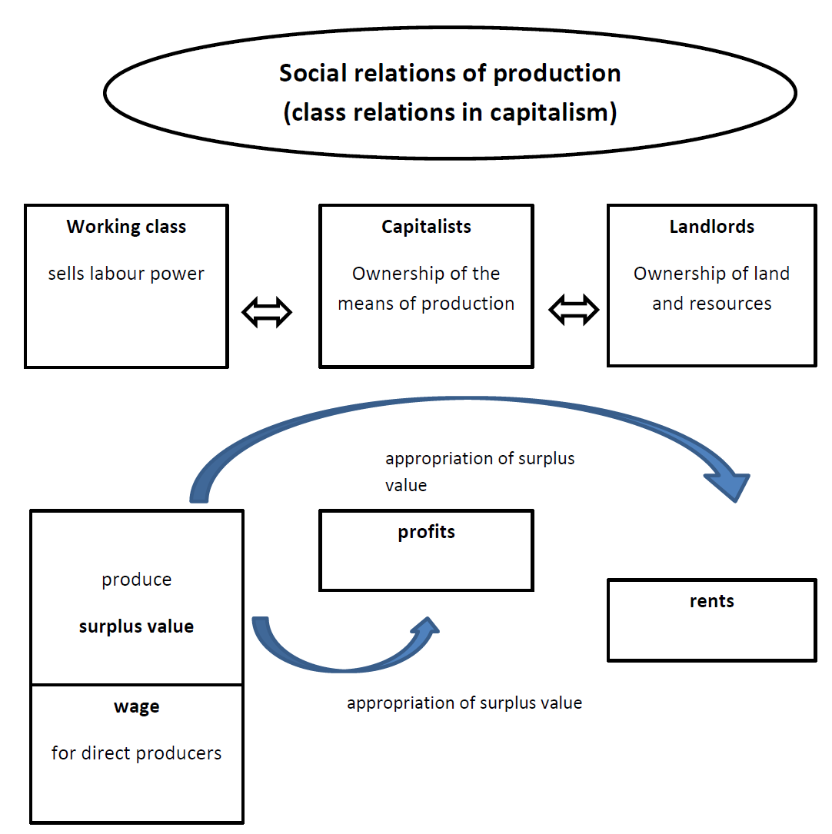
Social classes in political economy

Slide 14
The neoclassical circular-flow model
Revenue
MARKETS
Spending
FOR
GOODS AND SERVICES
Goods
Firms sell
Goods and
and services
Households buy
services
sold
bought
FIRMS
HOUSEHOLDS
Produce and sell
Buy and consume
goods and services
goods and services
Hire and use factors
Own and sell factors
of production
of production
Factors of
MARKETS
Labor, land,
production
FOR
and capital
FACTORS OF PRODUCTION
Wages, rent,
Households sell
Income
and profit
Firms buy
= Flow of inputs
and outputs
= Flow of dollars

Slide 15
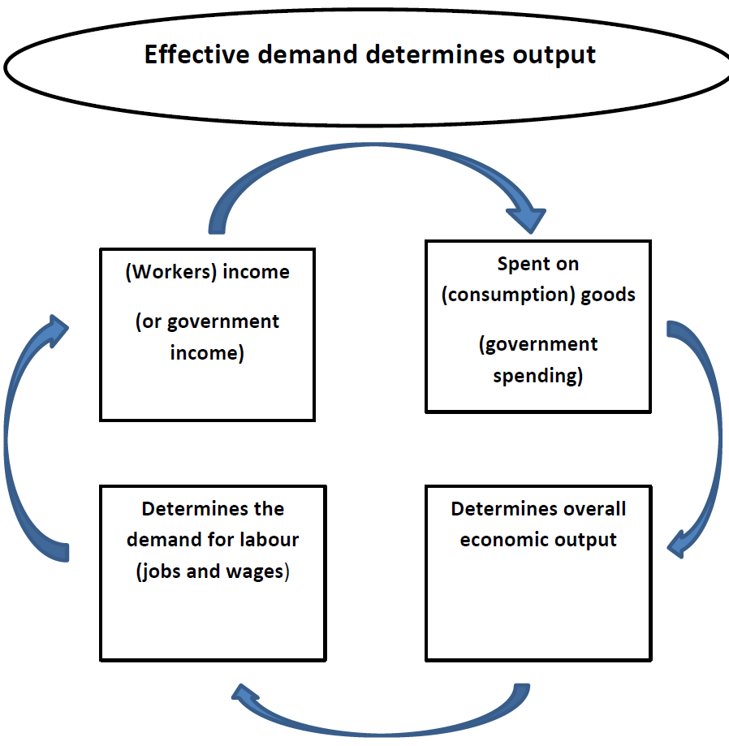
The Keynesian effective aggregate demand model

Slide 16
4. Different backgrounds in the philosophy of science
Critical Rationalism (Positivism) (Karl Raimund Popper)
Positive statements and normative statements can be separated
Economics can and should be free of value judgments
→ there is one economic truth
Critical Realism (Roy Bhaskar)
Multiple determination in open systems (the economy): innumerous perspectives and causal relations
economists have to choose a perspective (paradigm) and are always part of society
→economists have to be selective and truth always depends on the perspective
Neoclassical economics tends to based on Critical Rationalism
Political economy /Post-Keynesianism often relies on Critical Realism
Notes:
30

Slide 17
5. What are important questions in economics?
How to organize production in society (what, how, for whom etc.)?
Different historical forms to organize the economy:
hunter-gatherer society
feudal system
planned economy
capitalist system (free market economy, social market economy)

Slide 18
6. Outline of the lecture / book
How do different paradigms understand the economy? (chap. 2)
What is the role of the state in the economy and what should it be? (chap. 3)
How to explain economic growth and crisis? (chap. 4)
Why is there inequality and how should economic wealth be distributed? (chap. 5)
What is the role of money and the financial sector in the economy? (chap. 6) (Monetary theory and policy)
How to explain the geography of the (global) economy? (chap. 7)

