Slide 1

A Critical Introduction to Economics
Slides based on the book by Jäger/Springler: Ökonomie der Internationalen Entwicklung. Eine kritische Einführung in die Volkswirtschaftslehre
Chapter 6:
Money and Financial Markets

Slide 2
6.1.1 Neoclassical economics: General Approach
Dichotomy between monetary sphere and the real economy
Rule-based monetary policy
Efficient markets and behavioural finance

Slide 3
6.1.2 Key-concepts in neoclassical economics
Money demand
Money supply
Neoclassical Synthesis: The ISLM Model
International monetary macroeconomics

Slide 4
(1) Money demand
Say’s law: money as a medium of exchange
Classical Quantity Theory of Money:
  M*v ≡ P * Y
Monetarist approach:
  M^{d} = F (Y^{P},h,P, r_{B},r_{E}, w_{P}, u)

Slide 5
(2) Money supply
Monetary base determined by the central bank
Money multiplier: m = (1+c) / (c+r+e)

Slide 6
(3) The Neoclassical Synthesis: the ISLM model
IS-Curve: Equilibrium in the goods market
LM-Curve: Equilibrium in the financial/money market
IS-LM: Short run equilibrium
IS-LM supposes that the price level does not change

Slide 7
(4) International Monetary Macroeconomics
Balance of payments
Explaining the exchange rate
  Short term equilibrium: interest rate parity
  Long term equilibrium: purchasing power parity
The Mundell-Fleming Model

Slide 8
6.1.3 Implications for economic policy
Monetary policy should be based on rules and focus on price stability
Money supply target is preferred over interest rate target
ISLM model shows impact of monetary policy
Taylor rule as a pragmatic approach for central banks
Different transmission mechanisms show possible effects of monetary policy
Efficient Market Hypothesis suggests that financial markets guarantee efficient outcome
Behavioural finance and insights based on asymmetric information imply that regulations (e.g. in order to increase transparency) may have positive effects on markets

Slide 9
6.2.1 Keynesianism: general approach
Critique of neoclassical approach and “Bastard Keynesianism”
Endogenous money

Slide 10
6.2.2 Key-concepts in Keynesianism
Endogenous Money
Horizontalist and structuralist approach
Theory of monetary circuit

Slide 11
(1) Endogenous Money
Credit money
Critique of exogenous money in neoclassical economics

Slide 12
(2) Horizontalist and structuralist approach
Money supply depends on the demand for loans
Horizontalist (accomodationists) highlight dependence of banks on central banks
Structuralists focus on the power of banks to create financial means e.g. via securitization

Slide 13
(3) Theory of Monetary Circuit
Focuses on the connection between production and finance
Creation of money ex nihilo
Central banks less important

Slide 14
6.2.3 Implications for economic policy
Monetary policy focussing on money supply is considered ineffective
Money supply is not the key to explain inflation
Interest rate target is recommended
Nominal wages (and productivity) determine inflation
Inflation targeting and NAIRU (non inflation rate of unemployment) are criticized and MURI (minimum unemployment inflation rate) is proposed instead

Slide 15
6.3.1 Critical Political Economy: General Approach
Money is a symbol and an expression of societal relations
Different functions of money (medium of exchange, unit of account, store of value)
Money is central to capitalist accumulation:
  M-C-M’
  M-M´
Money, interest and fictitious capital
Regulation of money
Financial crisis are a central feature of capitalist economies

Slide 16
6.3.2 Key-concepts in critical political economy
Global financial hierarchy and the development of international monetary regimes
Financialization and financial crises

Slide 17
(1) Global financial hierarchy and the development of international monetary regimes
  Monetary constraint and the international dimension
  Historical international monetary regimes
    The Gold Standard and loss of autonomous monetary policy
    The Bretton Woods System with capital controls and fixed exchange rates provides a context for “embedded finance” → autonomous national monetary policy possible
    The Dollar Wall Street Regime (1979-) implies almost no limits to the global reserve currency but limits the national policy space of the rest of the world

Slide 18
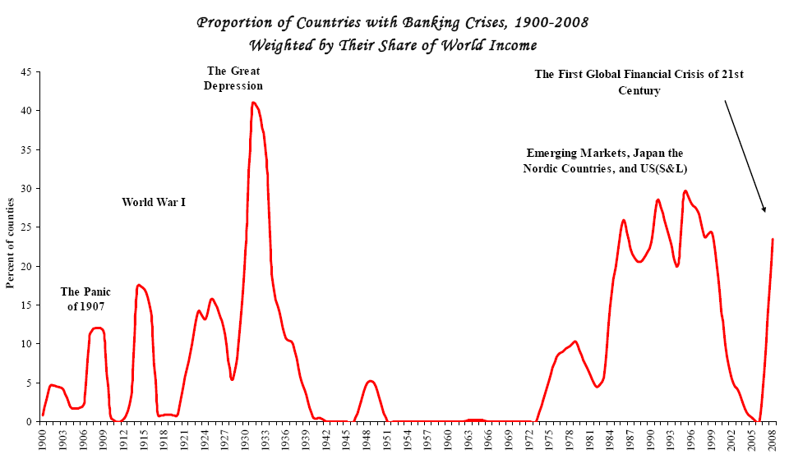
(2) Financialization and financial crises
Banking and financial crisis are common, but relative stability during the Bretton Woods period
Source:
Reinhart/Rogoff (2008)

Slide 19
Financialization (1970s-)
Financialization and finance-dominated patterns of accumulation in the context of the Dollar-Wall Street regime characterized by
  Finance and financial capital becoming the driving force
  Growth of financial markets due to an increase of supply (capital seeking possibilities to invest) within the context of a more unequal distribution of income (“shareholder-value orientation”)
  Financial investment gets “de-linked” from expected profits/interests
Consequences:
  Boom/bust cycles and frequent crisis in the global periphery
  Financial crises of 2008 in the global core countries

Slide 20
6.3.3 Implications for economic policy
Money, monetary policy and the configuration of the financial sector are socially contested and change over time
Historically different global monetary regimes determine the limits of national monetary policy strategies
Money and finance are closely linked to overall accumulation patterns
Progressive strategies aim at solidaristic international monetary regimes and de-financialization

