Slide 1
Musk buys
This month in the Economy

Slide 2
Learning objectives
Understanding how one person can buy/acquire a company
Understanding the impact of the acquisition for the company
Develop some financial literacy and understanding of corporate governance

Slide 3
What happened?
Right Before
Right After
7500 employees globally
Publicly traded company
Share Value = $54
Board of Directors
Around 3700 employees
“Private” company
Share Value = $???
Musk sole director
Notes:
Twitter has undergone some huge changes, many of which you may have noticed like the blue/white tick.
He started off by heavily cutting the Twitter workforce in half. Due to many of the new changes and demands from Musk, many workers also decided to leave the company.
End of October Musk dissolved the board of directors and became the sole director of Twitter. However, according to the papers, he is likely to appoint a new board, which is also required by law, of friends and investors that helped with the acquisition, and he has also stated he would appoint a new CEO.
They will also go from being a publicly traded company on the New York Stock Exchange to being a private company. As a result of the acquisition, Twitter has now been delisted from the stock exchange. But what does that mean? → Next slide

Slide 4
“Going private. As part of Mr. Musk’s acquisition of Twitter, he is delisting the company’s stock and taking it out of the hands of public shareholders. Making Twitter a private company gives Mr. Musk some advantages, including not having to make quarterly financial disclosures. Private companies are also subject to less regulatory scrutiny.”
Conger and Hirsch (2022) in the New York Times
Notes:
Going private means less public/regulatory scrutiny such as the quarterly financial reports (income statements, balance sheets etc.)
By being a private company, Musk can more easily do large changes to the platform, finances, and priorities, without having to worry about the public investors (such as stock prices crashing).

Slide 5
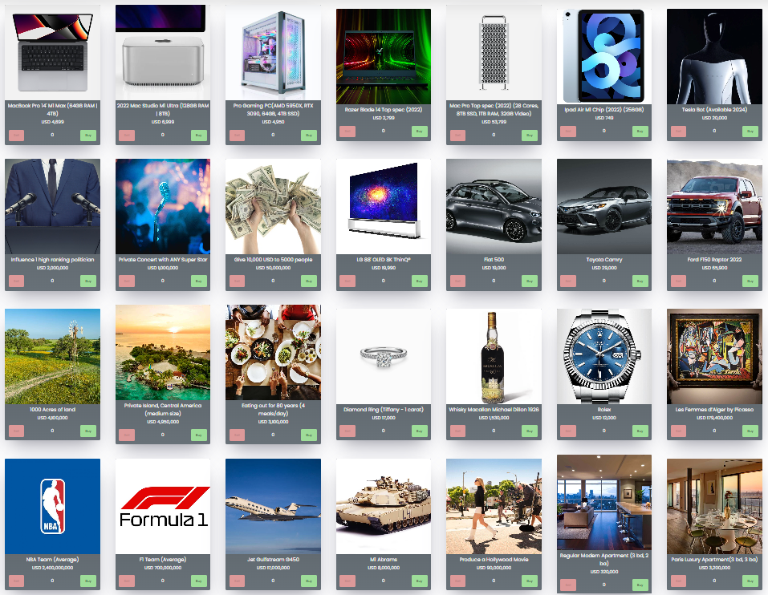
How much is $44 billion?
= $8.4 billion
Notes:
The cost of Twitter was 44 billion USD. But how much is really $44 billion? $43.700.000.000 to be exact.
1 of everything in the consumption bundle is $ 8,4 billion which includes buying a NBA and formula 1 team, a jet, a private island, a picasso painting, influencing a high ranking politician etc.

Slide 6
How do you buy Twitter?
Notes:
WORDCLOUD

Slide 7
Takeover: the purchase of one company by another. In the UK, the term refers to the acquisition of a public company whose shares are listed on a stock exchange, in contrast to the acquisition of a private company.
Buyout: The acquisition of a controlling interest in a company and is used synonymously with the term acquisition.
Merger: The legal union of two or more corporations into a single entity.
Acquisition: In an acquisition, one company purchases and absorbs the other into its operations.
Notes:
Which one of the following definitions are the most suitable?

Slide 8
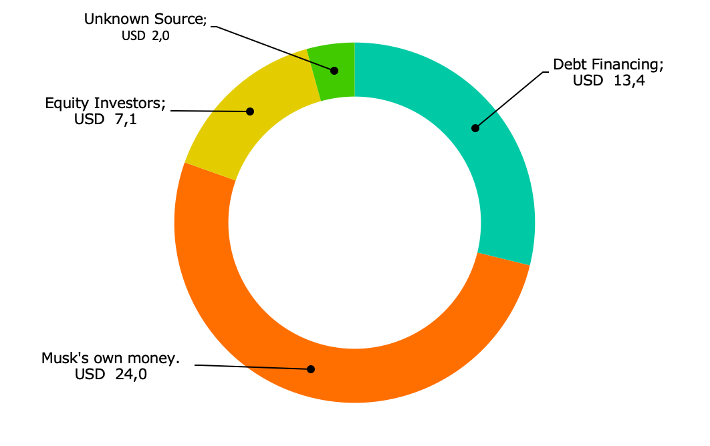
Where does the money come from?
TOTAL VALUE OF THE DEAL:
$46.5 Billion
Notes:
Total of 46.5 billion to finance deal (twitter being worth 44 billion, so 2.5 billion going to related costs of the deal)
33.5 billion equity commitment:
24 billion of this was from Musk himself, from which 4 billion was from his 9.6% ownership stake in Twitter that he already had and the rest he got from selling parts of his shares in Tesla.
The 2 billion from the unknown source category might also be from Musk himself and is also part of the equity commitment.
7 billion came from other equity sources such as Oracle Corp (ORCL.N) co-founder Larry Ellison and Saudi Prince Alwaleed bin Talal
13.4 billion debt financing
Loans backed by his shares in Tesla as collateral with banks such as Morgan Stanley and Bank of America providing the debt financing.

Slide 9
Musk
X Holdings
Twitter
Notes:
To buy Twitter Musk is merging it with X Holdings, a holding company he established to buy Twitter.
X is buying all of Twitter’s stock, and will then control the company, then Musk controls X.

Slide 10
In groups of 3-4: Discuss… (5 min)
Who has benefitted from the takeover?
Who has lost out from the takeover?
Should large platforms have different ownership and governance rules to other companies?

Slide 11
@twitterchallenge in 280 characters
Write a “tweet” capturing the effect the twitter acquisition will have on either:
The economy
The public sphere
Its workers
You personally

