Slide 1






An introduction into (not) taxing wealth and profits - The Dutch case
Notes:
Image source: https://aidc.org.za/what-are-illicit-financial-flows-and-base-erosion-and-profit-shifting/

Slide 2
Overview
Introduction
  Opening explanation
  Quiz
Taxing private wealth
  International: Zucman (2014)
  The Netherlands: Leenders & Lejour (2023)
Taxing corporate profits
  International: Zucman (2014)
  Exercise 1: Find the missing profits
  The Netherlands: Vleggeert & Vording (2019)
  Exercise 2: Power mapping
Wrap up

Slide 3

Intro: Topic & Relevance

Slide 4
Learning objectives
Understanding the basics of tax evasion and avoidance of individuals and multinational corporations
Being aware of the international role of the Netherlands in taxing multinational corporations
Being able to put recent policy developments in historical context
Being able to analyse power dynamics and relations

Slide 5
Quiz
 | Multinational corporations | Individuals
Tax evasion
Tax avoidance
Notes:
Tax evasion is often explained as illegal, while tax avoidance is supposed to be within the letter of the law. Sometimes tax avoidance is, however, still illegal as might go against the spirit of the law. The distinction between the two is often used for strategic reasons, trying to convince others that their way of preventing paying tax is legal.
Corporate: This profit-shifting is typically done within the letter of the law and thus would be best described as tax avoidance rather than fraud or tax evasion.
Individuals: Wealthy individuals, too, use tax havens, sometimes legally—to benefit from banking services not available in their home country—and sometimes illegally—to evade taxes.

Slide 6

Case 1: You do not report the gold bar you have in your vault to the tax authorities.
Tax evasion
Tax avoidance
Notes:
https://www.amazon.com/MosBug-35oz-Fake-Bullion-Paperweight/dp/B007W0SD3C

Slide 7


Case 2: The copyrights of the music of Rolling Stones and U2 were located in a letterbox company in Amsterdam.
Tax evasion
Tax avoidance
Notes:
https://www.amazon.com/MosBug-35oz-Fake-Bullion-Paperweight/dp/B007W0SD3C

Slide 8


Case 3: The Baby-BV
Parents create a Dutch bv (private limited liability company), give the shares to their baby, run the company as employees and in this way do not have to pay inheritance taxes.
Tax evasion
Tax avoidance
Notes:
https://myprivacy.dpgmedia.nl/consent?siteKey=V9f6VUvlHxq9wKIN&callbackUrl=https%3A%2F%2Fwww.ad.nl%2Fprivacy-gate%2Faccept-tcf2%3FredirectUri%3D%252Feconomie%252Fdirecteur-zit-nog-in-de-luiers-maar-omzeilt-de-erfbelasting~a2c49bba%252F
https://www.taxence.nl/nieuws/op-prinsjesdag-meer-duidelijkheid-over-baby-bvs/

Slide 9
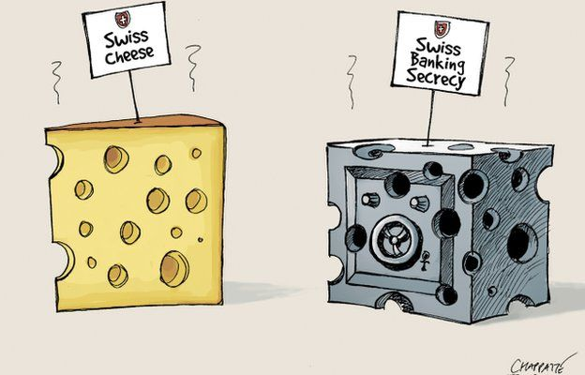
Case 4: A Dutch moderately rich entrepreneur kept part of his savings in a secret bank account in Switzerland.
Tax evasion
Tax avoidance
Notes:
https://www.amazon.com/MosBug-35oz-Fake-Bullion-Paperweight/dp/B007W0SD3C

Slide 10
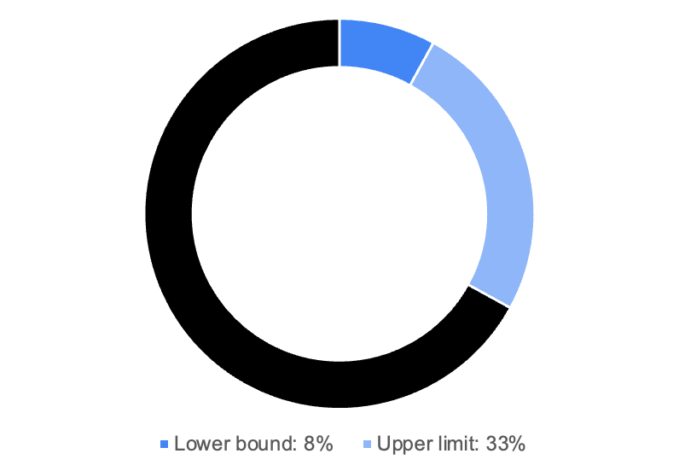
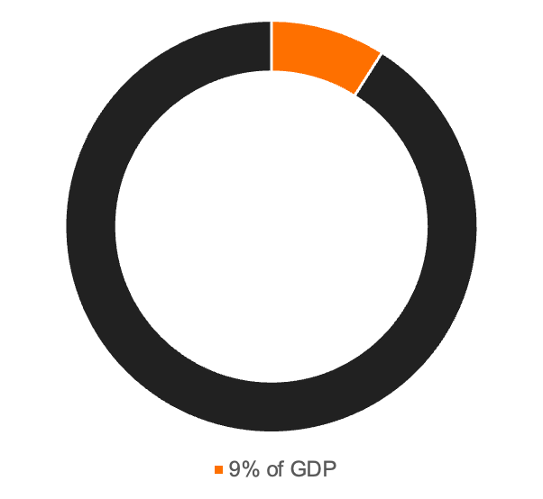
Taxing private wealth
Hidden private wealth of the richest 10% Dutch households in 2015
Global private wealth hidden in tax havens in 2012-3

Slide 11
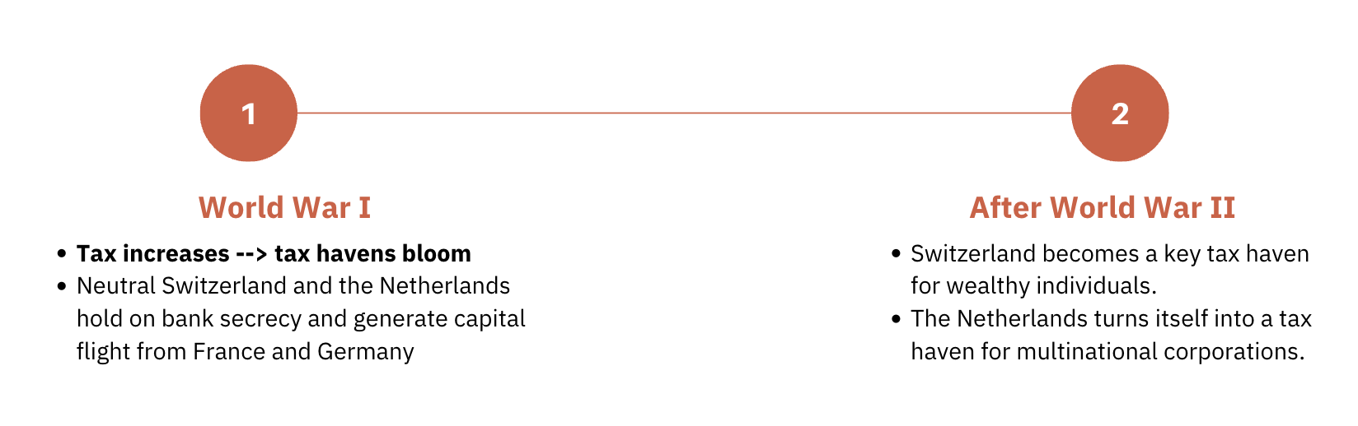
The History of Tax Havens

Slide 12



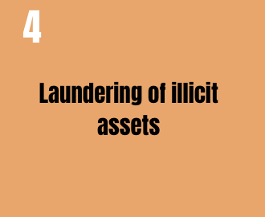
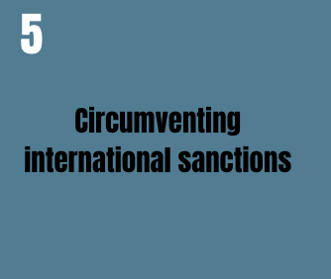
Reasons to hide Private Wealth

Slide 13
Voluntary disclosure scheme
Individuals can get fines for tax evasion. In theory the fine can amount to 300% of the evaded taxes, but in practice this is generally lower depending on the cooperation of the individual once the tax evasion has been discovered.
In 1998-2009 and 2013-2014 there were voluntary disclosure schemes through which individuals could report wealth that they had illegally hidden before without paying a fine for it.
In the Netherlands, especially moderately rich people (0.2-10% richest who owned up to €6 million) made use of these voluntary disclosure schemes. In other places like Scandinavia and Colombia, in contrast, mostly the super rich made use of them. What can explain this difference?
Notes:
Answers to the last question on the slide can be given by students or the teacher:
Evading taxes is easier for moderately rich people in the Netherlands than elsewhere.
We are unable to identify the super rich that did disclose their wealth becomes of complex intransparent tax constructions.
The super rich pay less taxes in the Netherlands compared to Scandinavia so there is less reason to engage in illegal tax evasion.
The Dutch super rich emigrate to Belgium, Switzerland and the UK to evade taxes.

Slide 14
More automatic exchange of information → Less wealth in tax havens
2005-2015:
European Union Savings Directive (EUSD)
EU member states had to choose between one of these two options:
  Automatic exchange of bank accounts to enable other countries to effectively tax its residents.
  Having a withholding tax on interest and savings incomes on the bank accounts of foreign households.
Shortcomings:
Wealth moved to not-participating countries
Shell companies were founded
Savings were converted into other forms of wealth like insurance products

Slide 15
2015-today: OECD Common Reporting Standard (CRS)
Improvements:
  Obligatory automatic exchange of information
  More countries participated (including Luxembourg and Switzerland)
  More types of financial assets, not only savings and interest payments
Shortcomings:
  Financial assets are converted into real estate assets as these are not included

Slide 16
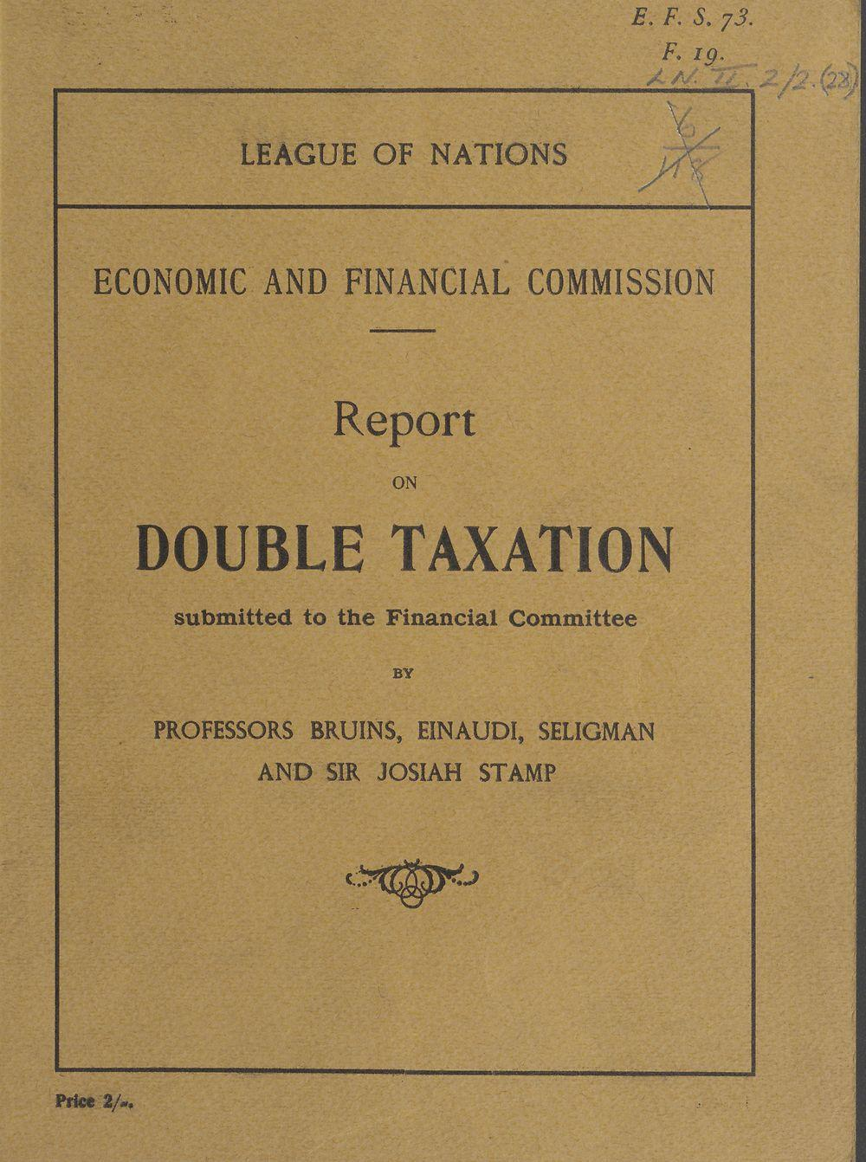
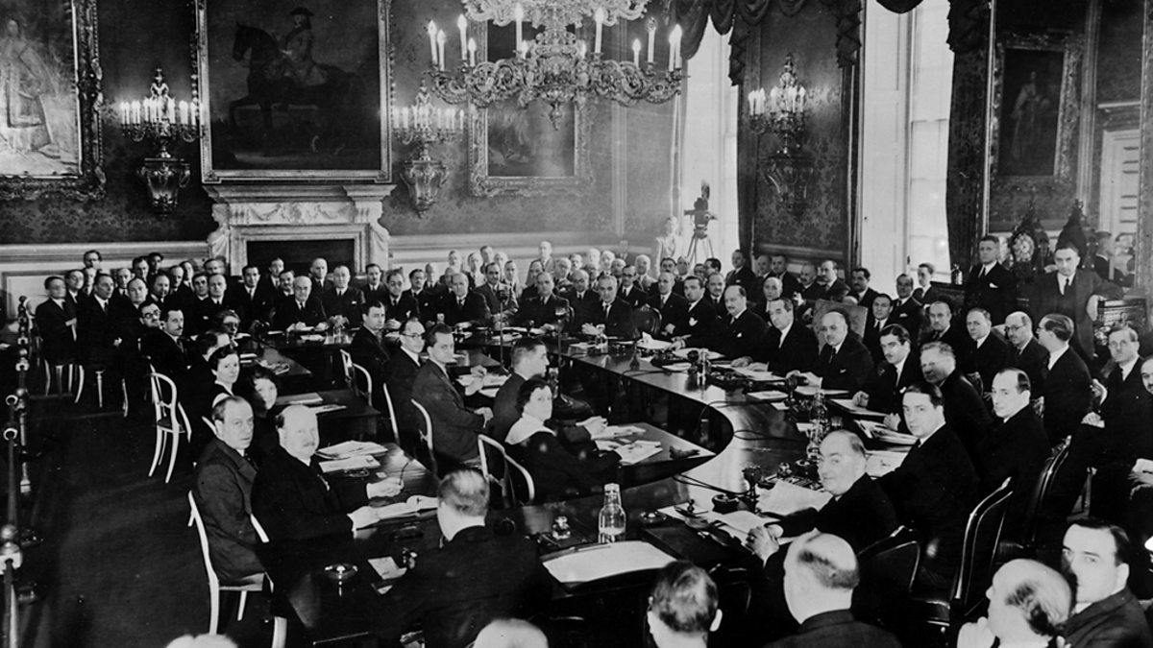
Taxing corporate profits
1923: The introduction of the corporate income tax led to concerns of double taxation of profits → League of Nations appointed a committee to solve this problem
Notes:
In most high-income countries, the corporate income tax was born just before or during World War I at about the same time as the personal income tax. Together they were meant to prevent tax dodging by taxing money that would be kept in the company to prevent the personal income tax.
But what is to be done when two countries seek to tax the same profits? In the 1920s, concerned with such double taxation, the League of Nations asked four economists to think about how best to avoid it (Bruins, Einaudi, Seligman, and Stamp 1923). They articulated three principles, which since then have been the pillars of international taxation.
Sources of images:
https://digital.nls.uk/league-of-nations/archive/190273783?mode=transcription
https://www.bbc.co.uk/programmes/b00fz8fb

Slide 17


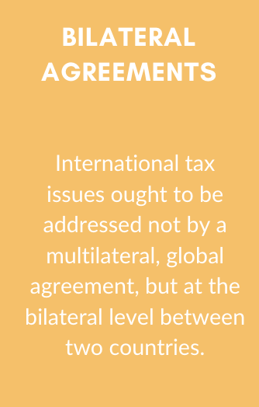



THE THREE PILLARS OF INTERNATIONAL TAXATION
Notes:
Source-based taxation: The corporate tax is to be paid to the source country’s government. In other words, corporate income is taxed in the place where it originates from, irrespective of whether they benefit residents or non-residents.
Arm’s length pricing: When a multinational corporation makes profits, it must divide its profits among its entities in different countries as if they were unrelated. In this way, the national ‘source’ of corporate income is identified and taxed.
Bilateral agreements: International tax issues ought to be addressed not by a multilateral, global agreement, but at the bilateral level between two countries. As a result, there are today many such bilateral agreements that have different rules and ways of resolving international tax issues.

Slide 18
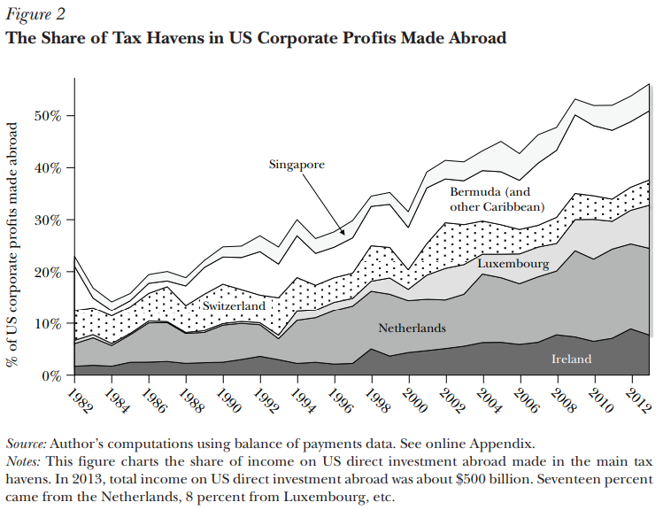

Slide 19
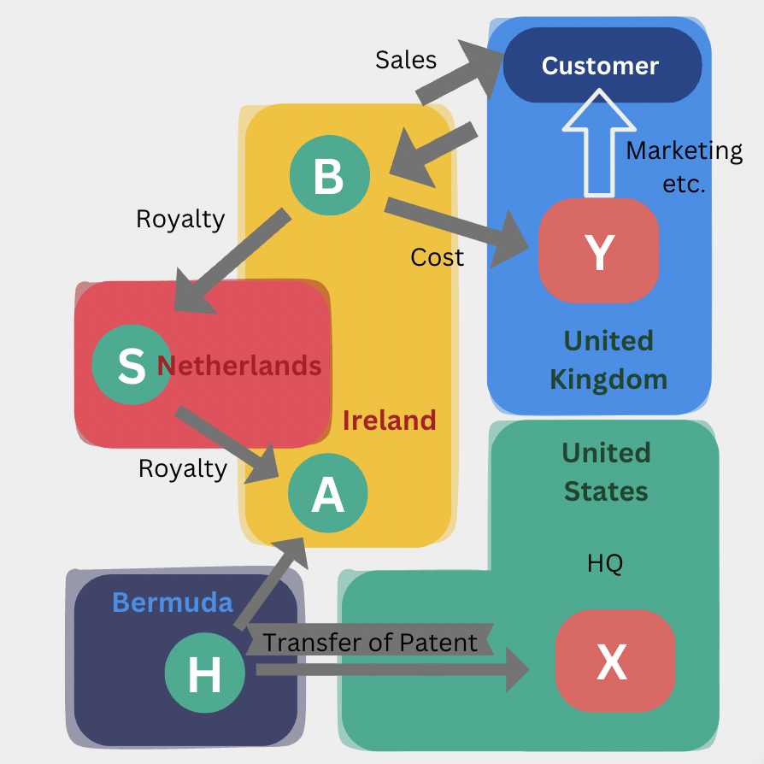
Problems with bilateral agreements
Treaty shopping: The bilateral agreements form a web of inconstant rules. This creates the opportunity for multinational corporations to exploit these inconsistencies by treaty shopping to avoid taxes.
Notes:
A prominent example is Google’s “double Irish Dutch sandwich” strategy, so named because it involves two Irish affiliates and a Dutch shell company squeezed in between. Followed by a complicated explanation of tax arrangement involving the US, Ireland, NL, France, and Bermuda.
Source image: https://en.wikipedia.org/wiki/Double_Irish_arrangement

Slide 20
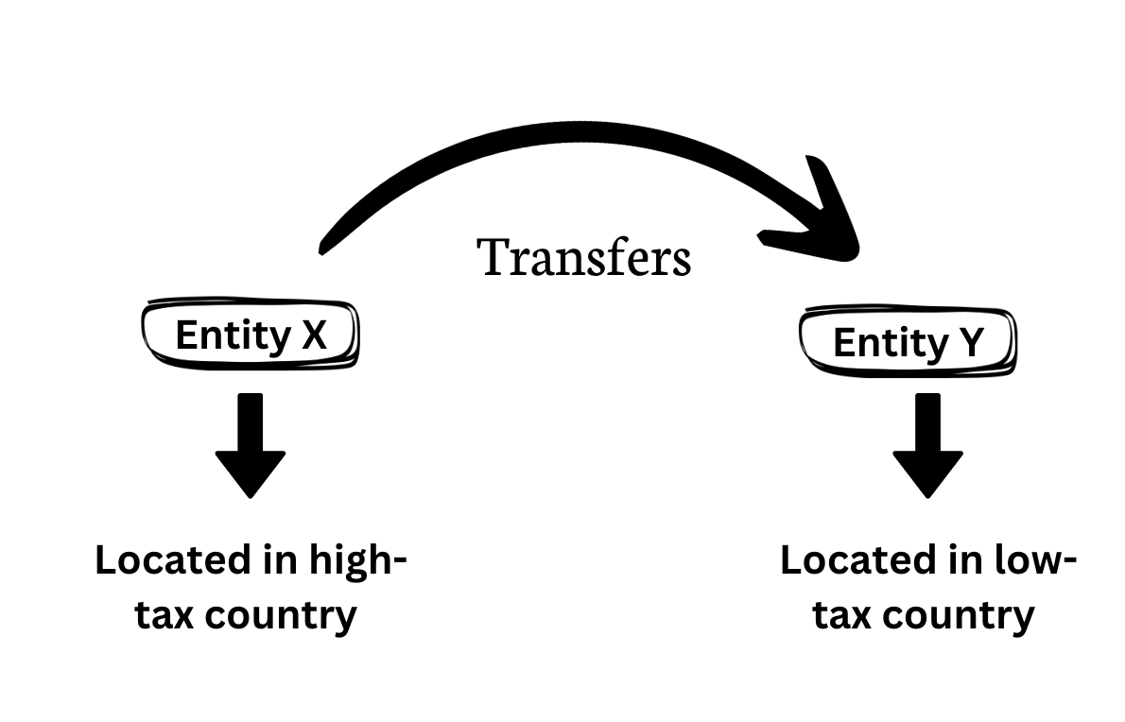
Problems with arm’s length pricing
Transfer mispricing
The issues raised by treaty shopping are compounded by the growing ability of multinational firms to choose the location of their profits, and thus exploit treaty inconsistencies, irrespective of where they produce or sell.

Slide 21
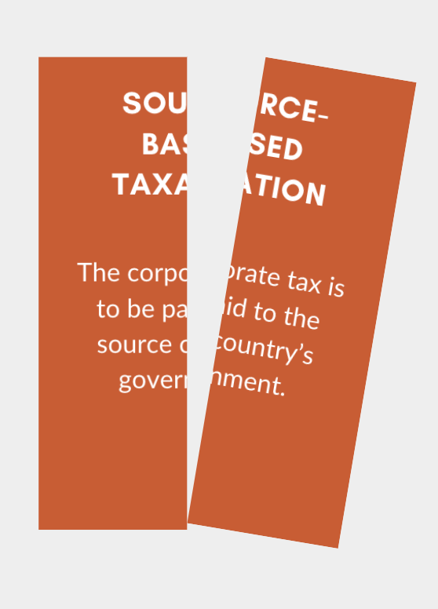
Problems with source-based taxation
Two types of inefficiencies:
Artificial profit-shifting: It causes a wasteful expenditure of resources on transfer pricing and treaty shopping by multinational companies and on curbing tax avoidance practices by tax authorities.
Moving real economic activities: It gives firms incentives to move real economic activities to where taxes are low.
Notes:
Image source: https://aidc.org.za/what-are-illicit-financial-flows-and-base-erosion-and-profit-shifting/

Slide 22
Proposals for corporate tax reforms
Abolish corporate income tax
More harmonisation of treaty rules
Abandoning arm’s length pricing for an apportionment formula
Abandoning source-based taxation for shareholder-based taxation
Integrating corporate and individual income taxes with an imputation system
Create a world financial registry
Notes:
Abolish corporate income tax:
Mankiw (2014): Abolish progressive corporate and personal income taxes and replace them with higher regressive consumption taxes
More harmonisation of treaty rules
Abandoning arm’s length pricing for an apportionment formula
To address artificial profit shifting, profits would instead be apportioned to each country according to some formula, possibly using a combination of sales, capital, and employment.
Abandoning source-based taxation for shareholder-based taxation
If the corporate tax is only a prepayment for the personal income tax, profits should not be attributed to the countries from which they originate, or where sales are made, but to the countries where shareholders live.
Integrating corporate and individual income taxes with an imputation system
Once profits are paid out to shareholders, the government allows any corporate tax previously withheld to be credited against the amount of personal income tax owed. This combines source- and shareholder-based taxation and removes incentives for firms to relocate or shift profits.
Create a world financial registry
The registry would include information on the residence and nationality of corporate shareholders, thus making it possible for countries to check whether the total taxes they levy on corporate profits—at both the corporate and shareholder level, net of credits—are in line with the corporate profits that indeed accrue to resident taxpayers.

Slide 23
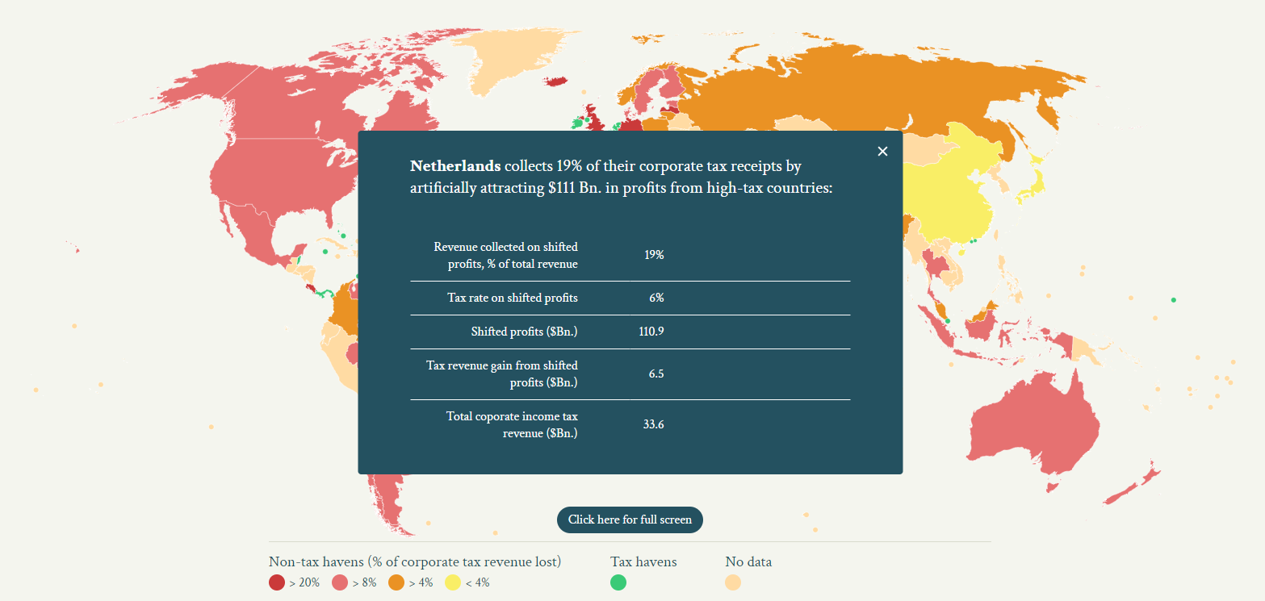

Slide 24
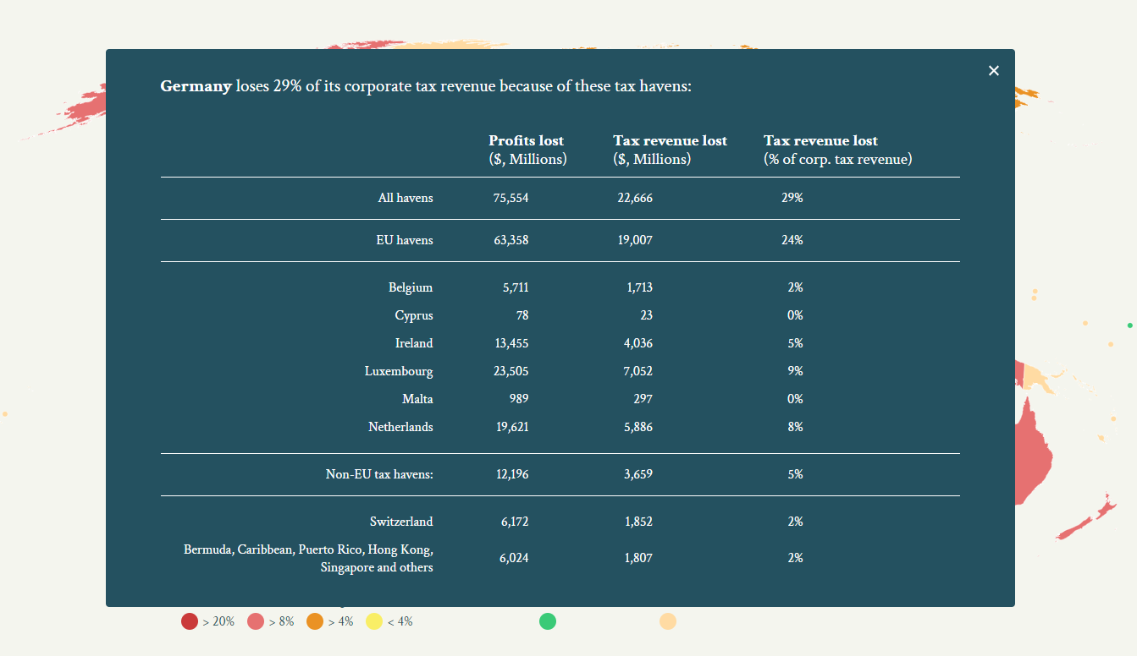

Slide 25
Exercise 1: Find the missing profits
Do these steps in groups of 2-3 in 15 min with the help of the exercise sheet:
Every student guesses for themselves the top 5 countries that lose most corporate tax revenue (in absolute terms) from the Netherlands. Write down the top 5 of each student next to each other.
Discuss and write down in your group what the reasons are you choose these countries and what can cause/explain high corporate tax losses to the Netherlands for countries.
Go to https://missingprofits.world/ and find out what the actual top 5 is by clicking on countries in the map. Write down the data regarding the Netherlands and all tax havens (absolute profits lost, absolute tax revenue lost, and relative tax revenue lost; in total thus 6 items per country) for each country that you click on.
Compare the results to your guesses of step 1 and discuss the similarities and differences.
Discuss which of reasons you discussed at step 2 seems to have led you in the right direction.

Slide 26
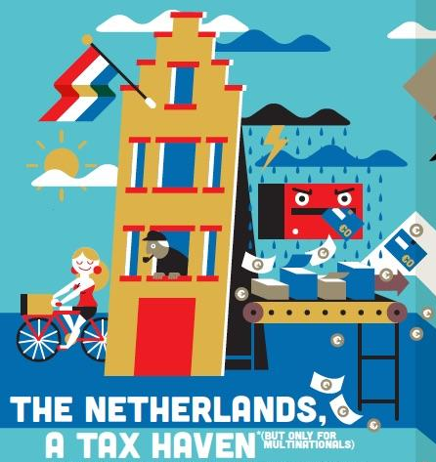

Slide 27
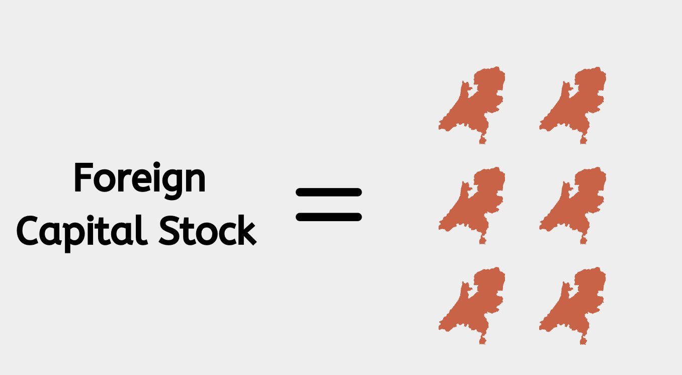
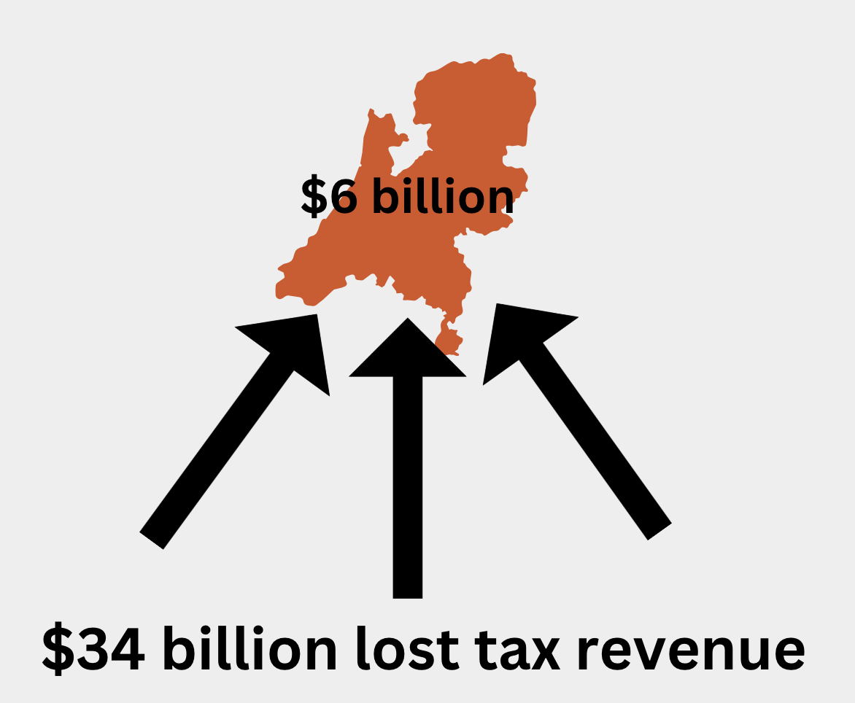
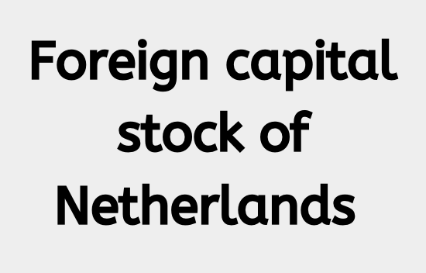
Financial flows through the Netherlands
Dutch GDP
Via letterbox companies
Notes:
Source for 2019: FD stuk
2017: Foreign capital stock of the Netherlands was €4.5 trillion (6 times GDP), and of this 70% were via letterbox companies (4 times GDP)
2019: $6 billion of corporate income tax collected by the Dutch government (2% of all Dutch tax revenues) at the expense of $34 billion lost corporate income tax revenues by other countries

Slide 28
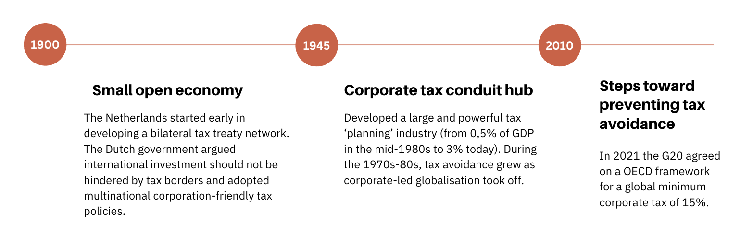
Emergence of the unique international tax position of the Netherlands

Slide 29

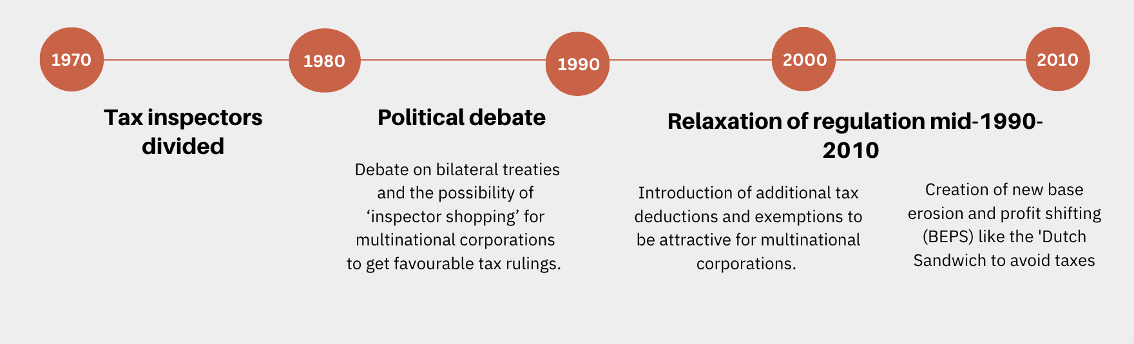
Dutch debate late 20th Century: Should the Dutch tax authorities facilitate international tax avoidance?

Slide 30
Dutch debate in the 21st century: Should the Dutch tax authorities facilitate international tax avoidance?
From 2008:
  The global financial crisis caused a change in public opinion worldwide with regards to taxation of multinational corporations. This has brought about policy changes, which have been reinforced by the OECD and G20 Base Erosion and Profit Shifting (BEPS) Project since 2013 and the EU Anti Tax Avoidance Directive (ATAD) since 2016.
  NGOs like SOMO, Oxfam Novib, and Tax Justice, had some success in arguing that the Netherlands had acquired a hub function in MNE tax planning. But in political circles, the response remained: our tax system meets all the international standards.
From 2017: Dutch tax policy remains committed to creating an ‘attractive investment climate’ for multinational corporations, but no longer aims to attract ‘letterbox companies’.

Slide 31
A note on terms
Is the Netherlands a ‘tax haven’, ‘conduit country’, simply has an ‘attractive investment climate’, or has a lot of ‘economic freedom’?
Do we talk about tax avoidance, tax planning, tax saving, or lost tax revenues?
Notes:
Answers to these questions differ between groups. NGOs, academics and journalists generally give different answers than multinational corporations, lobbyists and tax advisers and lawyers. Framing an issue is always a key aspect of public debates. Therefore it is always important to be conscious and reflective about this, irrespective of whether you are on the receiving or producing side of the communication.
As the Netherlands became internationally known as tax haven or conduit country, it status and soft power was hurt. As a result, there were even motions in parliament to reject/ban calling NL a tax haven. At the same time, the government is trying to be seen as tackling tax avoidance as it is afraid it will hurt taxpayer compliance, real business attractiveness, and the ability to agree tax treaties with other countries.

Slide 32


The Tax Crown Jewels of the Netherlands
In 2015 the Dutch Senate & State Secretary of Finance reflect on the OECD and G20 Base Erosion and Profit Shifting (BEPS) Project.
Christian democratic senator Wopke Hoekstra asks:
"[T]he Dutch tax crown jewels [are] named: the participation exemption, the absence of withholding tax on interest and royalties, the extensive treaty network and the provision of security in advance. ... [I]n how far are you prepared to defend those crown jewels tooth and nail?"
Conservative liberal state secretary Eric Wiebes replies:
"I am of the opinion that the ... aspects mentioned ... are strengths in which untargeted and disproportionate countermeasures can have major consequences for our investment climate. The Netherlands has expressed these strengths during discussions within the OECD and EU and will continue to do so in the future."
Notes:
Source: https://zoek.officielebekendmakingen.nl/kst-25087-L.html
Original quotes in Dutch:
“[D]e Nederlandse fiscale kroonjuwelen [worden] benoemd: de deelnemingsvrijstelling, de afwezigheid van bronheffing op rente en royalty's, het uitgebreide verdragennetwerk en het geven van zekerheid vooraf. … [I]n hoeverre u bereid bent bereid om die kroonjuwelen met hand en tand te verdedigen?”
“Ik ben van mening dat de … genoemde aspecten … sterke punten zijn waarbij ongerichte en disproportionele tegenmaatregelen grote gevolgen kunnen hebben voor ons fiscale vestigingsklimaat. Nederland heeft deze sterktes uitgedragen tijdens discussies binnen de OESO en EU en blijft dat in de toekomst ook doen.”

Slide 33



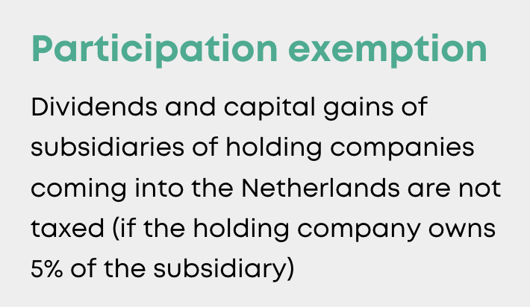
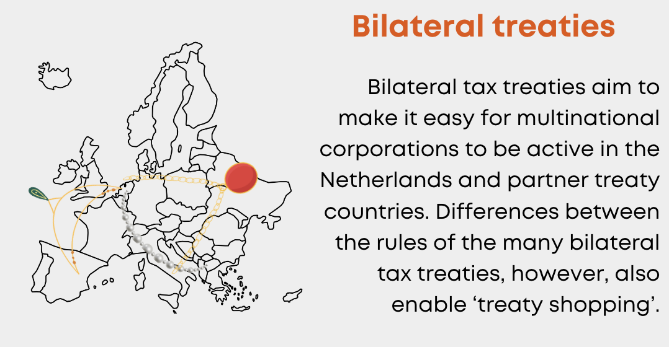

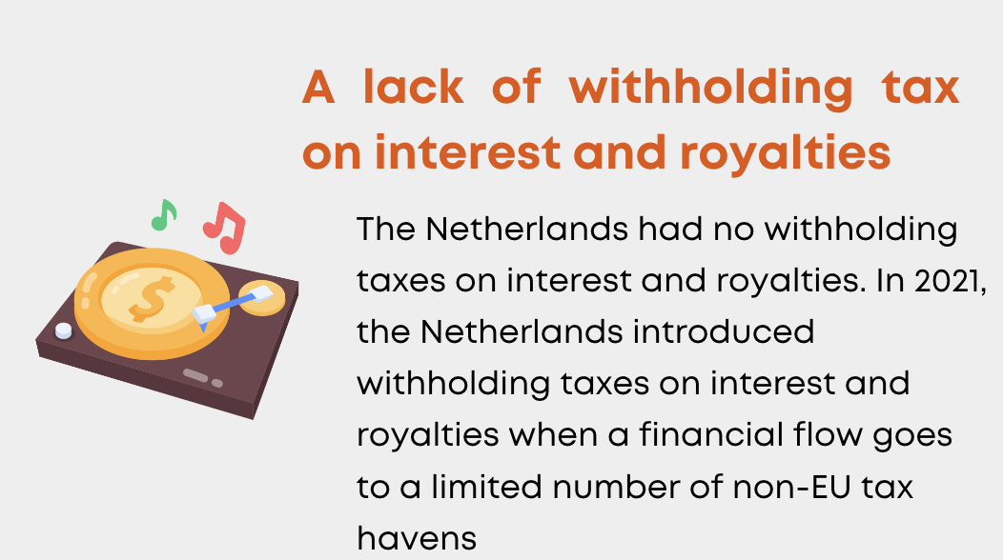
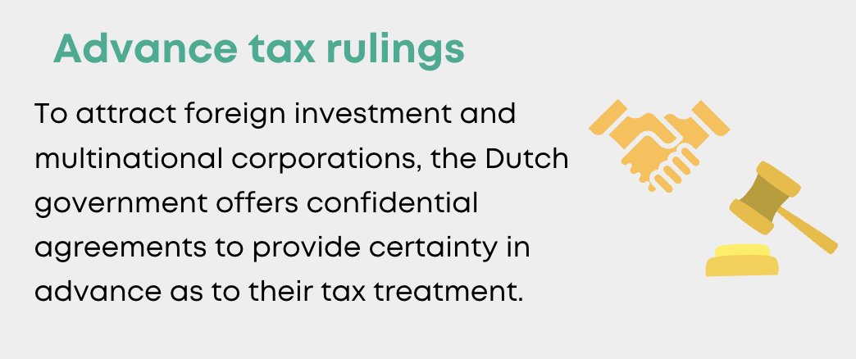

Slide 34
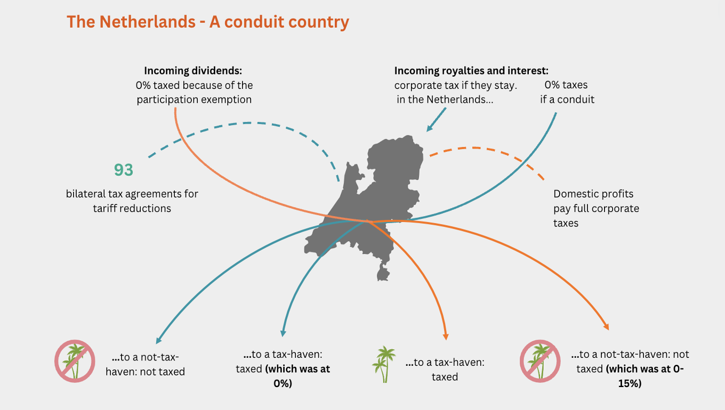
Notes:
Source image: https://www.cpb.nl/sites/default/files/omnidownload/Macro-Economische-Verkenning-MEV-2019.pdf

Slide 35

The Dutch Participation Exemption
Dividends and capital gains of subsidiaries of holdings companies coming into the Netherlands are not taxed (if the holding owns 5% of the subsidiary).
Profits of the subsidiary are already taxed in the country where it is operating and taxing the dividends paid to the holdings would amount to double taxation of corporate profits.
Foreign multinationals use the Netherlands to channel corporate profits and dividends to avoid taxation on them.
Since recent OECD policy changes, the average effective tax on dividends is around 1-2% while the official minimum 15% only applies to a small number of countries with few economic ties to the Netherlands.
Notes:
Dividends and capital gains of subsidiaries of holdings coming into the Netherlands are not taxed (if the holding owns 5% of the subsidiary)
The logic is that the profits of the subsidiary are already taxed in the country where it is operating and taxing the dividends paid to the holdings would amount to double taxation of corporate profits.
The result is that foreign multinationals use the Netherlands to channel corporate profits and dividends to avoid taxation on them.

Slide 36
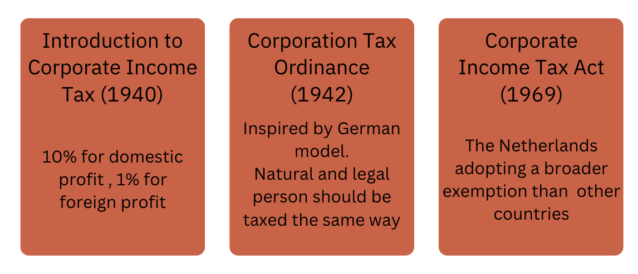
History of the Dutch Participation Exemption

Slide 37
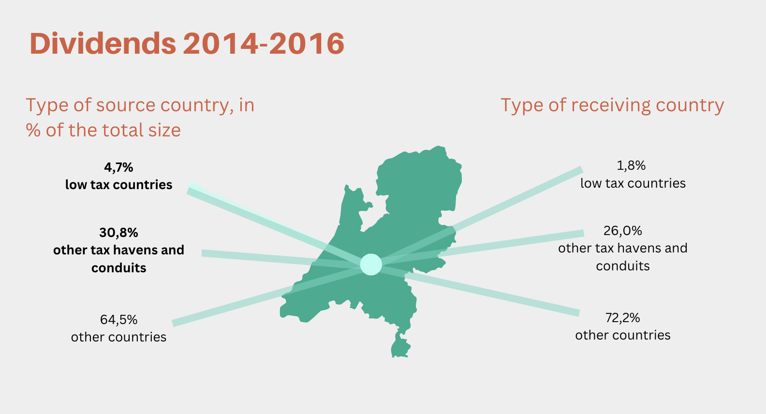
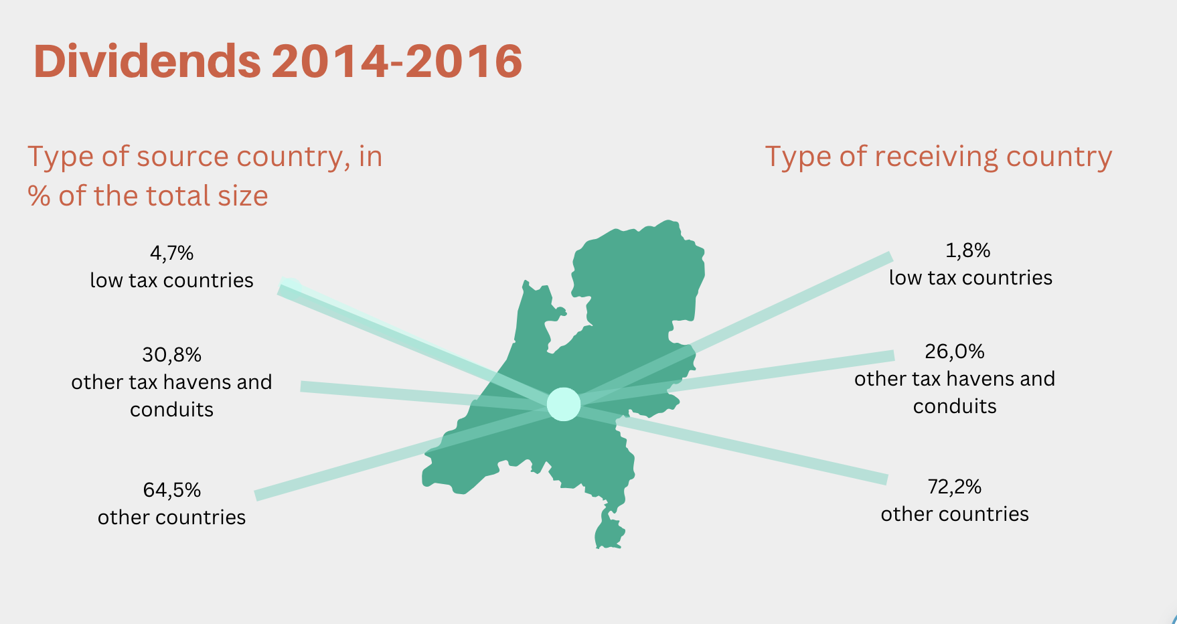
Notes:
https://www.cpb.nl/doorsluisland-nl-doorgelicht

Slide 38
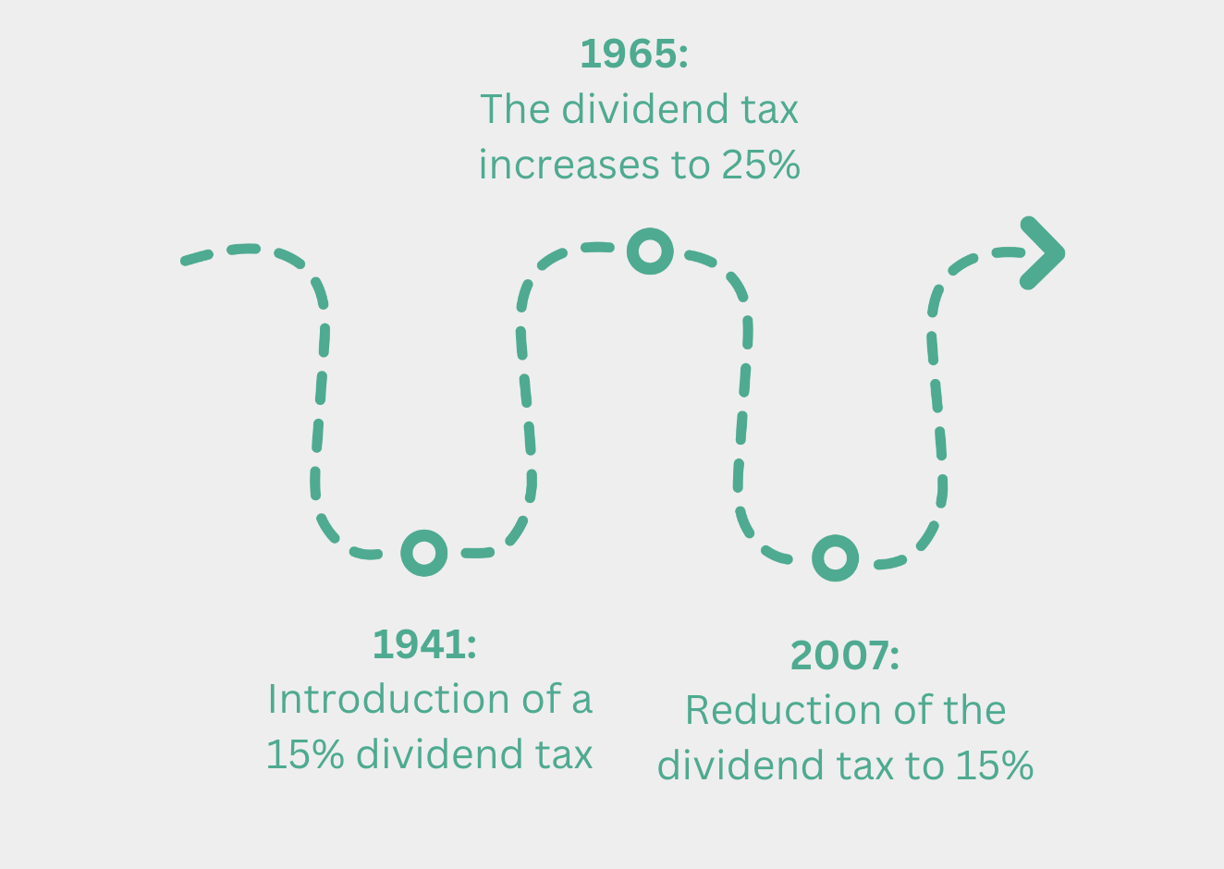
The dividend tax
Notes:
1941: Introduction of a 15% dividend tax
The dividend tax is in effect a creditable pre-tax on (individual or corporation) income tax to prevent tax avoidance.
1965: Increase of the dividend tax to 25%
The reason for this was that it helped in negotiations with other countries over bilateral tax treaties in which the Netherlands tried to make dividend taxes creditable in other countries.
2007: Reduction of the dividend tax to 15%
This was done as part of a larger package decided upon in 2003 of deductions and exemptions of taxes to attract more multinational corporations to the Netherlands.

Slide 39
2017-2018: Attempt to abolish the dividend tax and with that make the participation exemption redundant
The coalition agreement of Rutte III of 2017 stated the goal to abolish the 15% dividend tax. The reason was attract corporations to legally headquarter in the Netherland to benefit from the absence of a dividend tax.
The plan to abolish dividend tax proved so controversial that it was discarded in October 2018. This was a public loss for multinationals, prime minister Mark Rutte and his conservative liberal party VVD.
Instead, the cabinet lowered corporate income tax more than was initially planned to achieve the same amount of tax revenue reduction.

Slide 40

A lack of withholding taxes on interest and royalties
The Netherlands had no withholding taxes on interest and royalties.
In 1987, the government stated that the reason for this lack of taxation was that it aimed for unhindered international investment flows.
In 2021, the Netherlands introduced withholding taxes on interest and royalties when a financial flow goes to a limited number of non-EU tax havens.

Slide 41
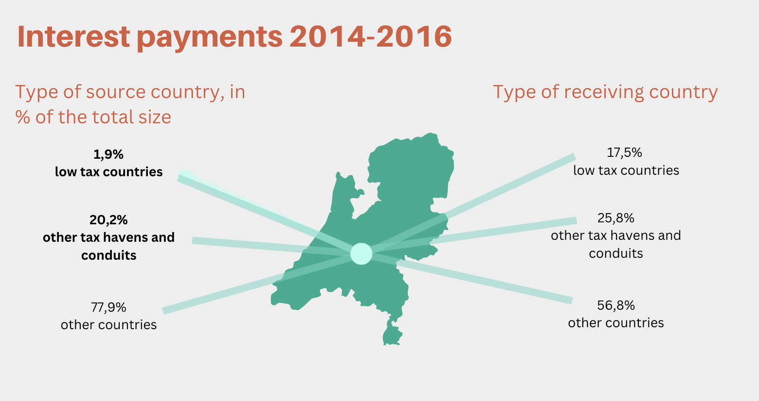
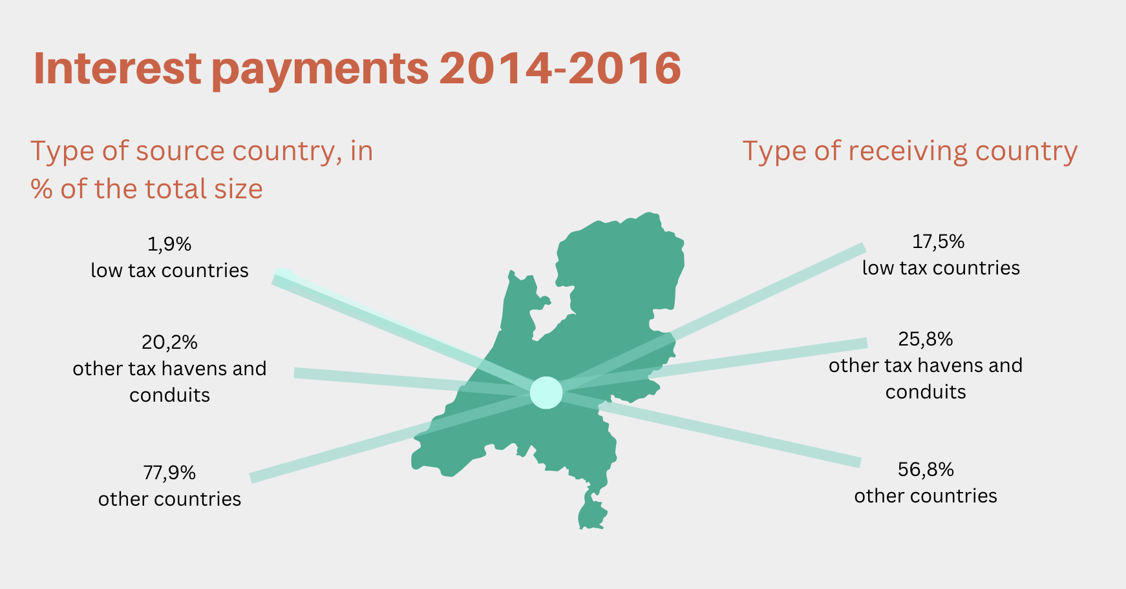
Notes:
https://www.cpb.nl/doorsluisland-nl-doorgelicht

Slide 42
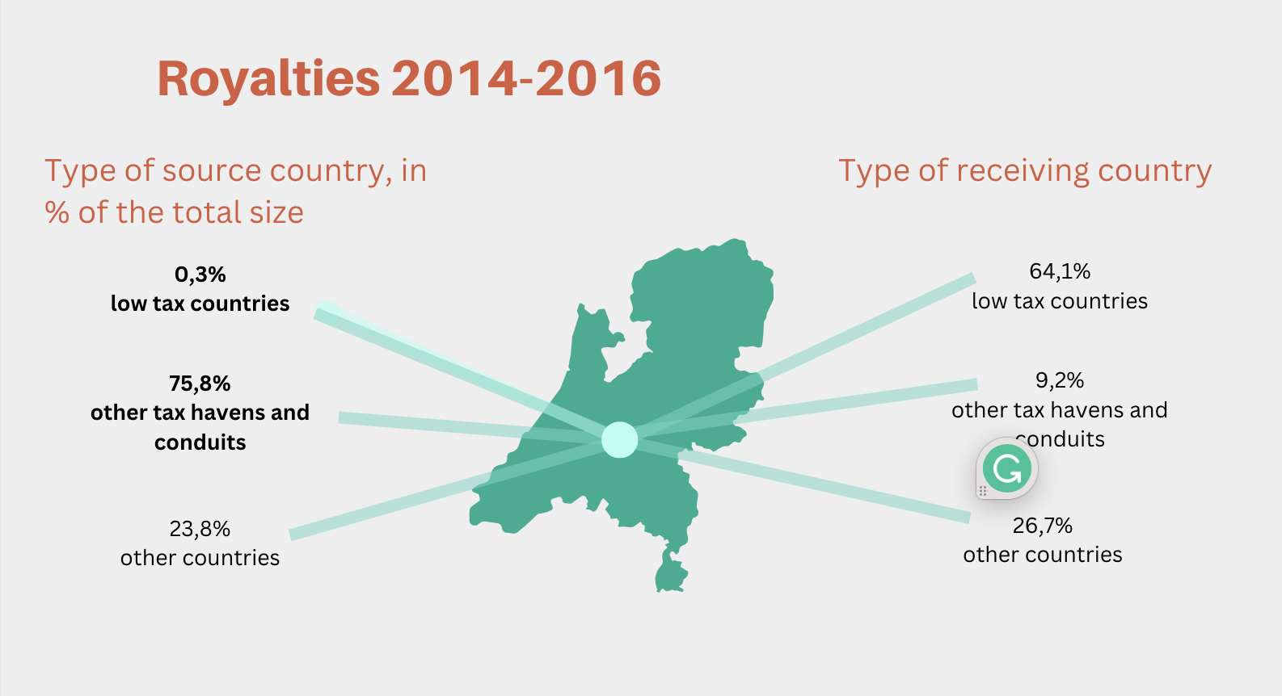
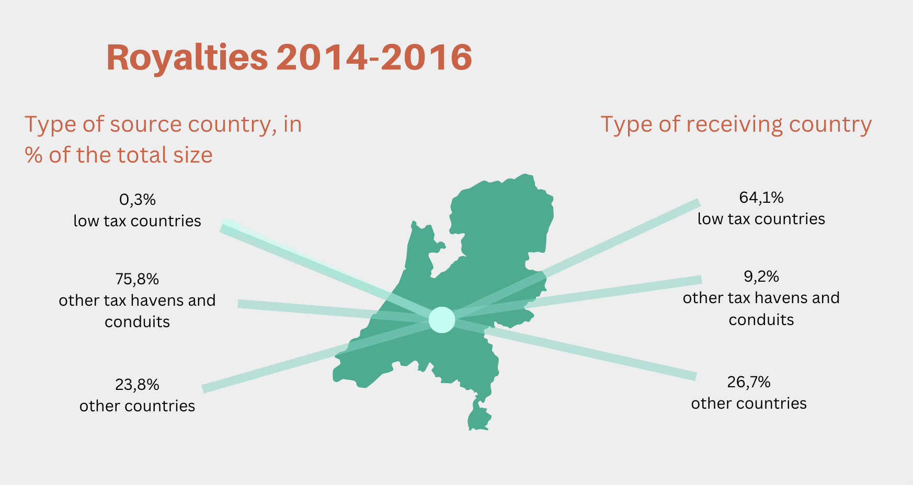
Notes:
https://www.cpb.nl/doorsluisland-nl-doorgelicht

Slide 43
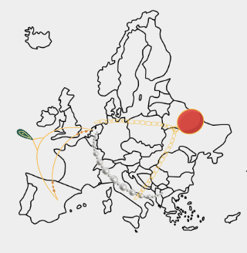
Bilateral tax and investment treaties
The Netherlands has been early and particularly successful in getting other countries to agree to low or no withholding taxes on dividends.
Differences between the rules of the many bilateral tax and investment treaties also enable ‘treaty shopping’, in which financial flows are relocated in order to advantage of inconsistencies.
The Netherlands is extra attractive as member state of the European Union and country in which laws related to conduit, or letterbox, companies are extra flexible.

Slide 44

History
Interwar 1930s: The Netherlands agreed its first general tax treaties based on the League of Nations models
Post-war decades: It made many more general tax treaties with other countries
1980s: As tax avoidance became more prevalent, it entered the Dutch political debate and other countries concerns.
Today: The Netherlands has almost a hundred bilateral tax and investment treaties, generally based on the OECD model convention.

Slide 45

Advance tax rulings
To attract foreign investment and multinational corporations, the Dutch government offers confidential agreements to provide certainty in advance as to their tax treatment.
Rulings are meant to address mismatches between Dutch corporate tax rules and those of other countries where multinationals are active.
Key here are informal capital rulings:
  The Netherlands allows deduction of a (fictitious) royalty or allows capitalization and amortization of intangible assets while no corresponding taxation takes place in the other country.
  This is not in line with the arm’s length principle as it allows for unilateral downward adjustment of profits and resulting in double non-taxation.

Slide 46
History of advance tax ruling
Post-war period 1945-mid 70s: The Ministry of Finance did the tax rulings for multinational corporations.
Since the mid-1970s: Corporation tax inspectors of the tax authorities do the rulings.
Many rulings up to the mid-1980s were not within the framework of Dutch tax law and did not follow the arm’s length principle.
1986: The government decided upon standardisation through a national tax ruling team which made inspector shopping no longer possible.
1995: Tax ruling policy was again relaxed as for example informal capital rulings were reintroduced.
2018: Tax ruling policy was made stricter. No longer provide rulings where the principal aim of the tax construction is to reduce Dutch tax revenues or profits are shifted to tax havens.

Slide 48
Exercise 2: Power mapping
Place the following actors in the graphs in the sheet for the two periods in the exercise sheet:
The general public
Politicians
Multinational corporations
Civil society organisations
Academic researchers
Tax lawyers and advisors
Tax inspectors
International organisations (EU, OECD, G20)
Discuss why they should be placed there and how this can help explain policy outcomes.

Slide 49


Slide 50

More powerful
Opposes tax avoidance
Favours tax avoidance
Less powerful

Slide 51
Wrap up
The three pillars of international taxation
  Source-based taxation
  Arm’s length pricing
  Bilateral agreements
Dutch tax crown jewels
  Participation exemption
  A lack of withholding taxes on interest and royalties
  Bilateral treaties
  Advance tax rulings

